Slide 1


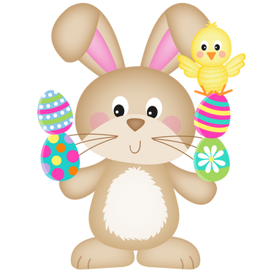




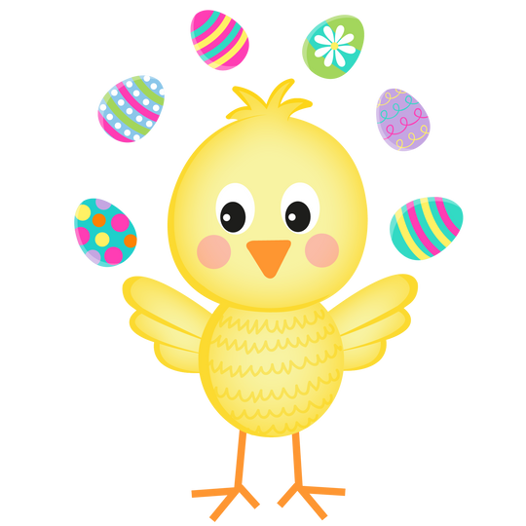
Easter
Kids Craft
Bundle

Slide 2


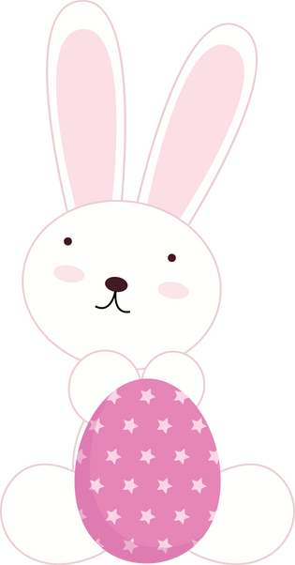



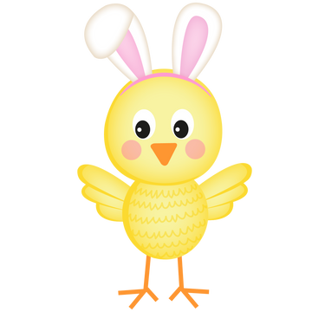



J
E
L
L
Y
B
E
A
N
O
O
C
C
T
P
A
R
A
D
E
G
G
M
A
Easter Activity Page
H
A
R
A
B
B
I
T
O
P
N
N
O
S
P
R
I
N
C
H
I
C
K
D
C
O
O
S
S
I
L
B
O
N
V
Y
Easter
Egg
Hunt
Chocolate
Rabbit
Chick
Spring
Flowers
Candy
Grass
Sunday
Parade
Decorate
Bonnet
Jellybean
Peeps
A
C
I
S
A
R
R
U
J
A
O
G
L
E
D
E
C
O
R
A
T
E
R
R
A
E
A
S
T
E
R
G
E
E
E
A
T
B
O
N
N
E
T
H
U
N
T
S
E
S
U
N
D
A
Y
R
E
G
G
S
F
L
O
W
E
R
S
P
E
E
P
S
Tic Tac Toe
How many
do you see?

Slide 3
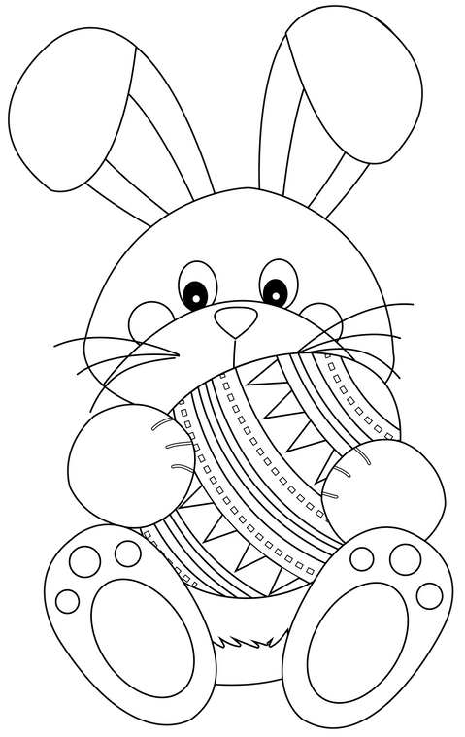

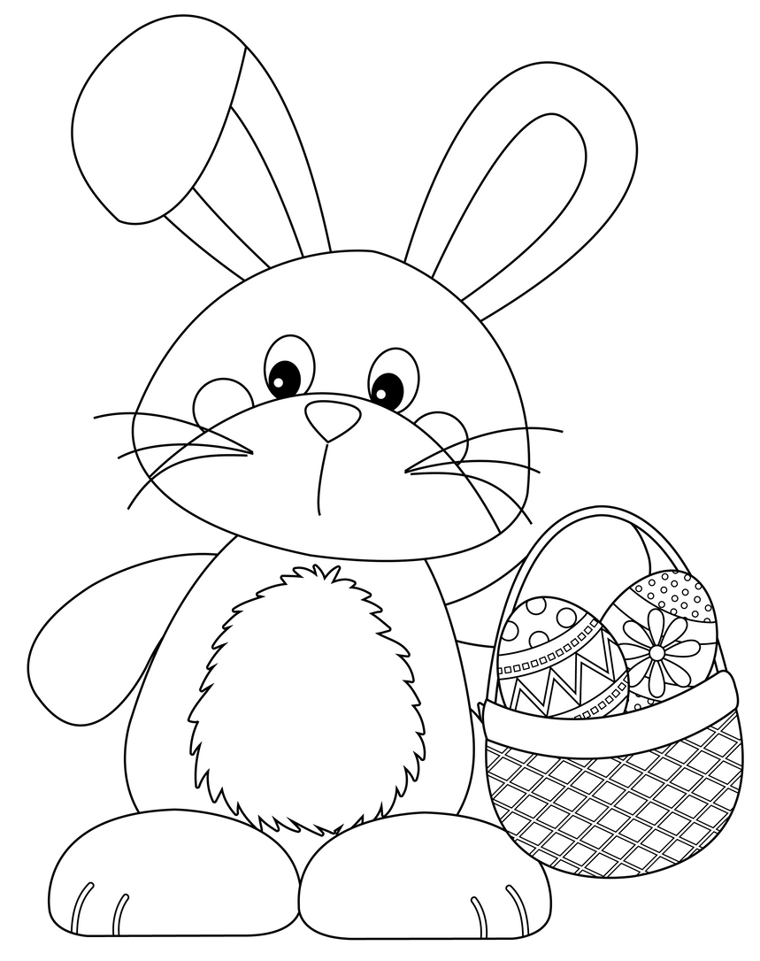
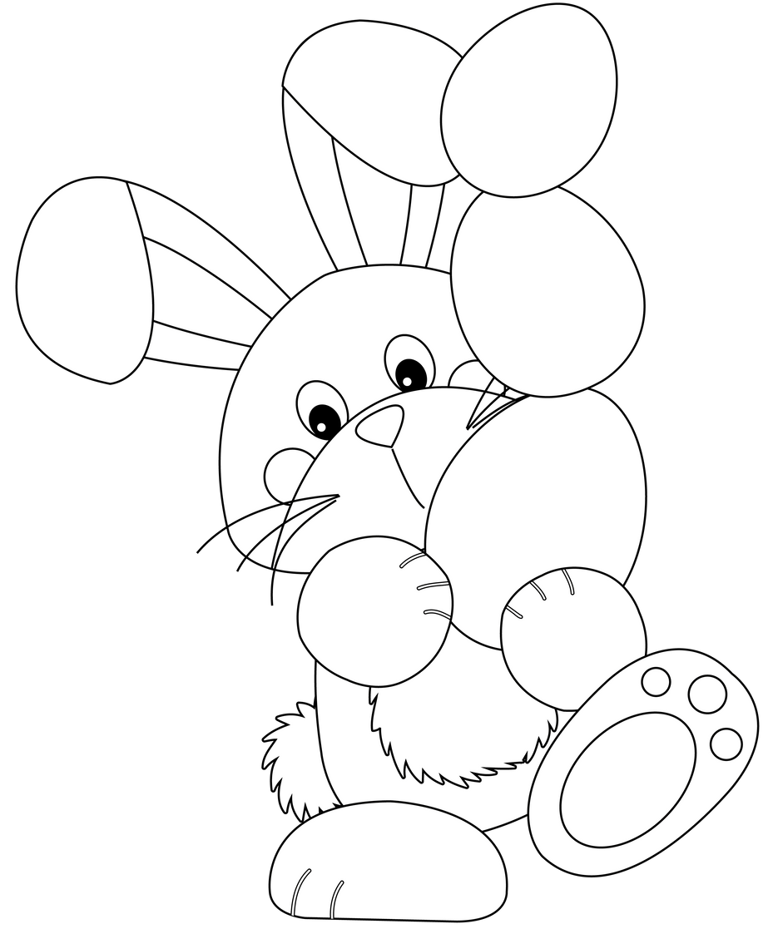
EASTER GAMES
COLOR ME
HELP THE DINO
COLOR ME
COLOR ME
WORD SCRAMBLE
TIC- TAC- TOE
TIC- TAC- TOE
TIC- TAC- TOE
rsaete
sgge
tnuh
sepep
ynadc

Slide 4
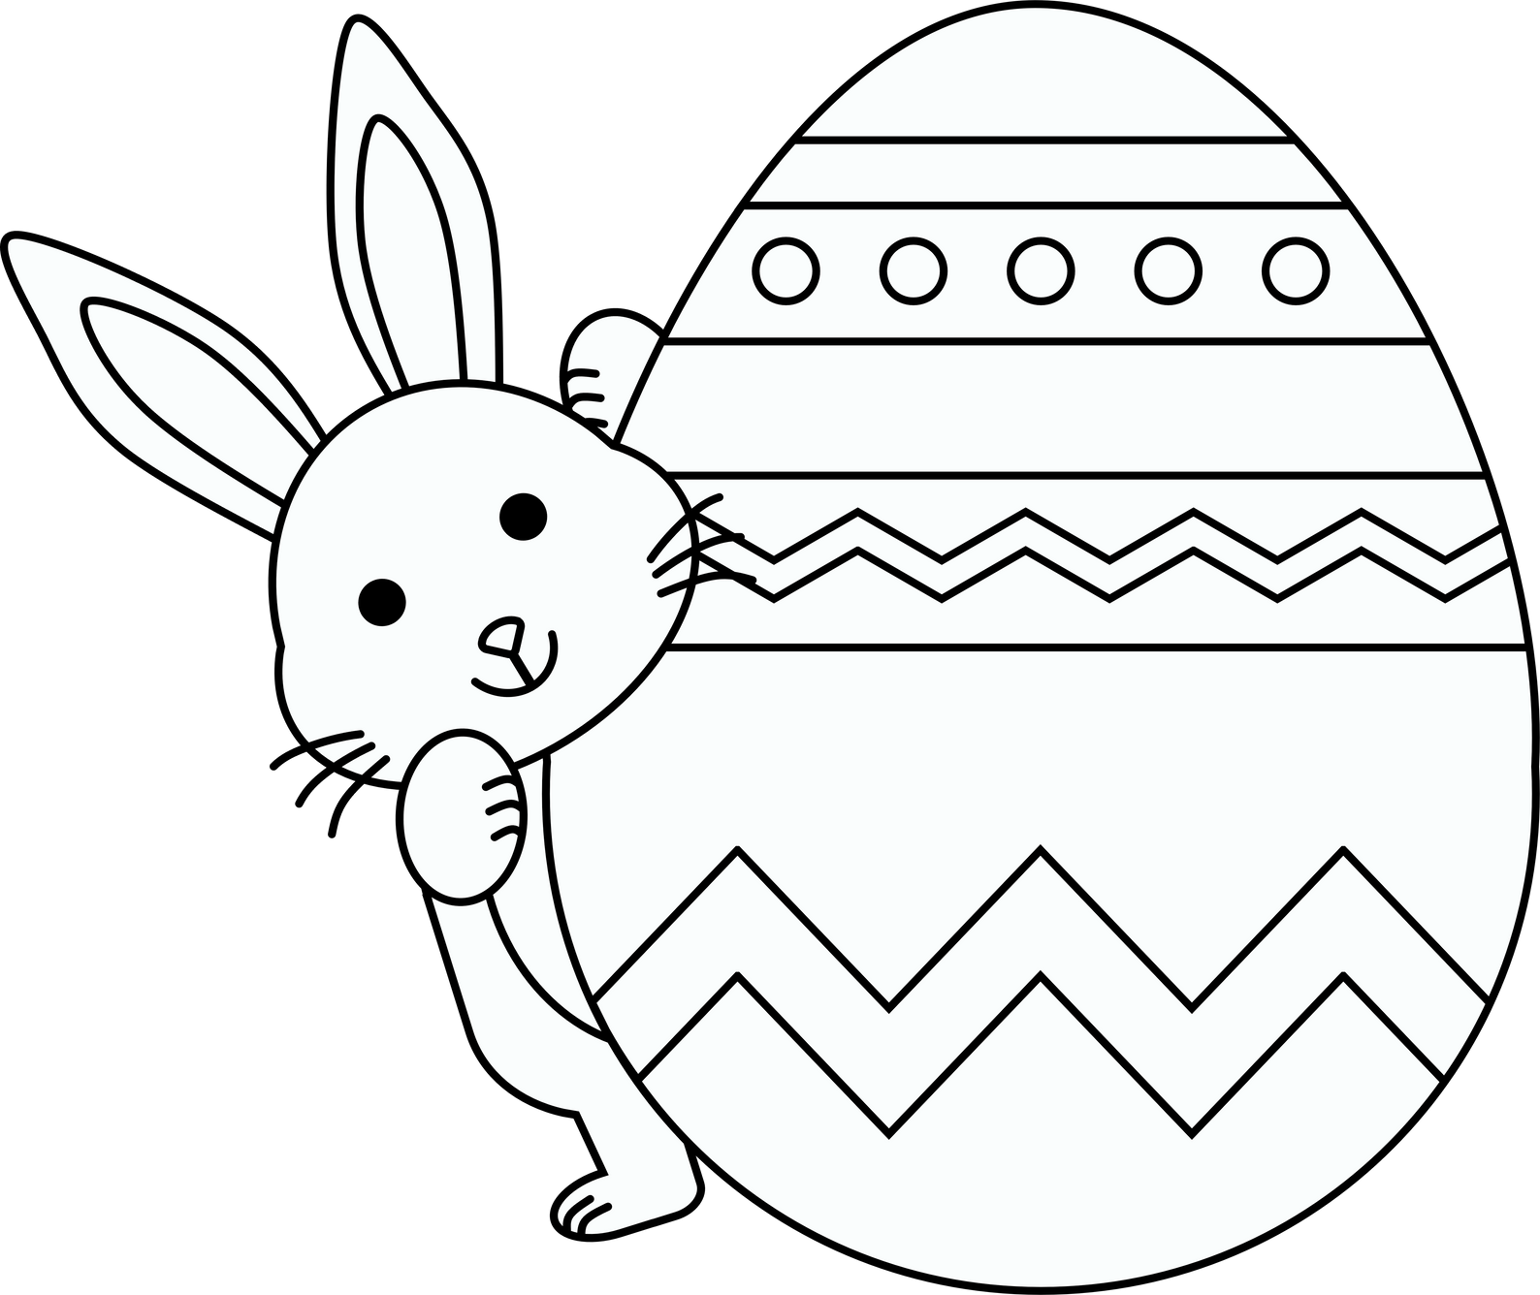

Easter COLOR BY NUMBER
3
5
1
3
4
1
2
5
6
1
4
4
4
6
3
2
5
1
4
4
4
3
2
Color Key:
1
purple
3
white
5
blue
2
yellow
4
pink
6
orange

Slide 5
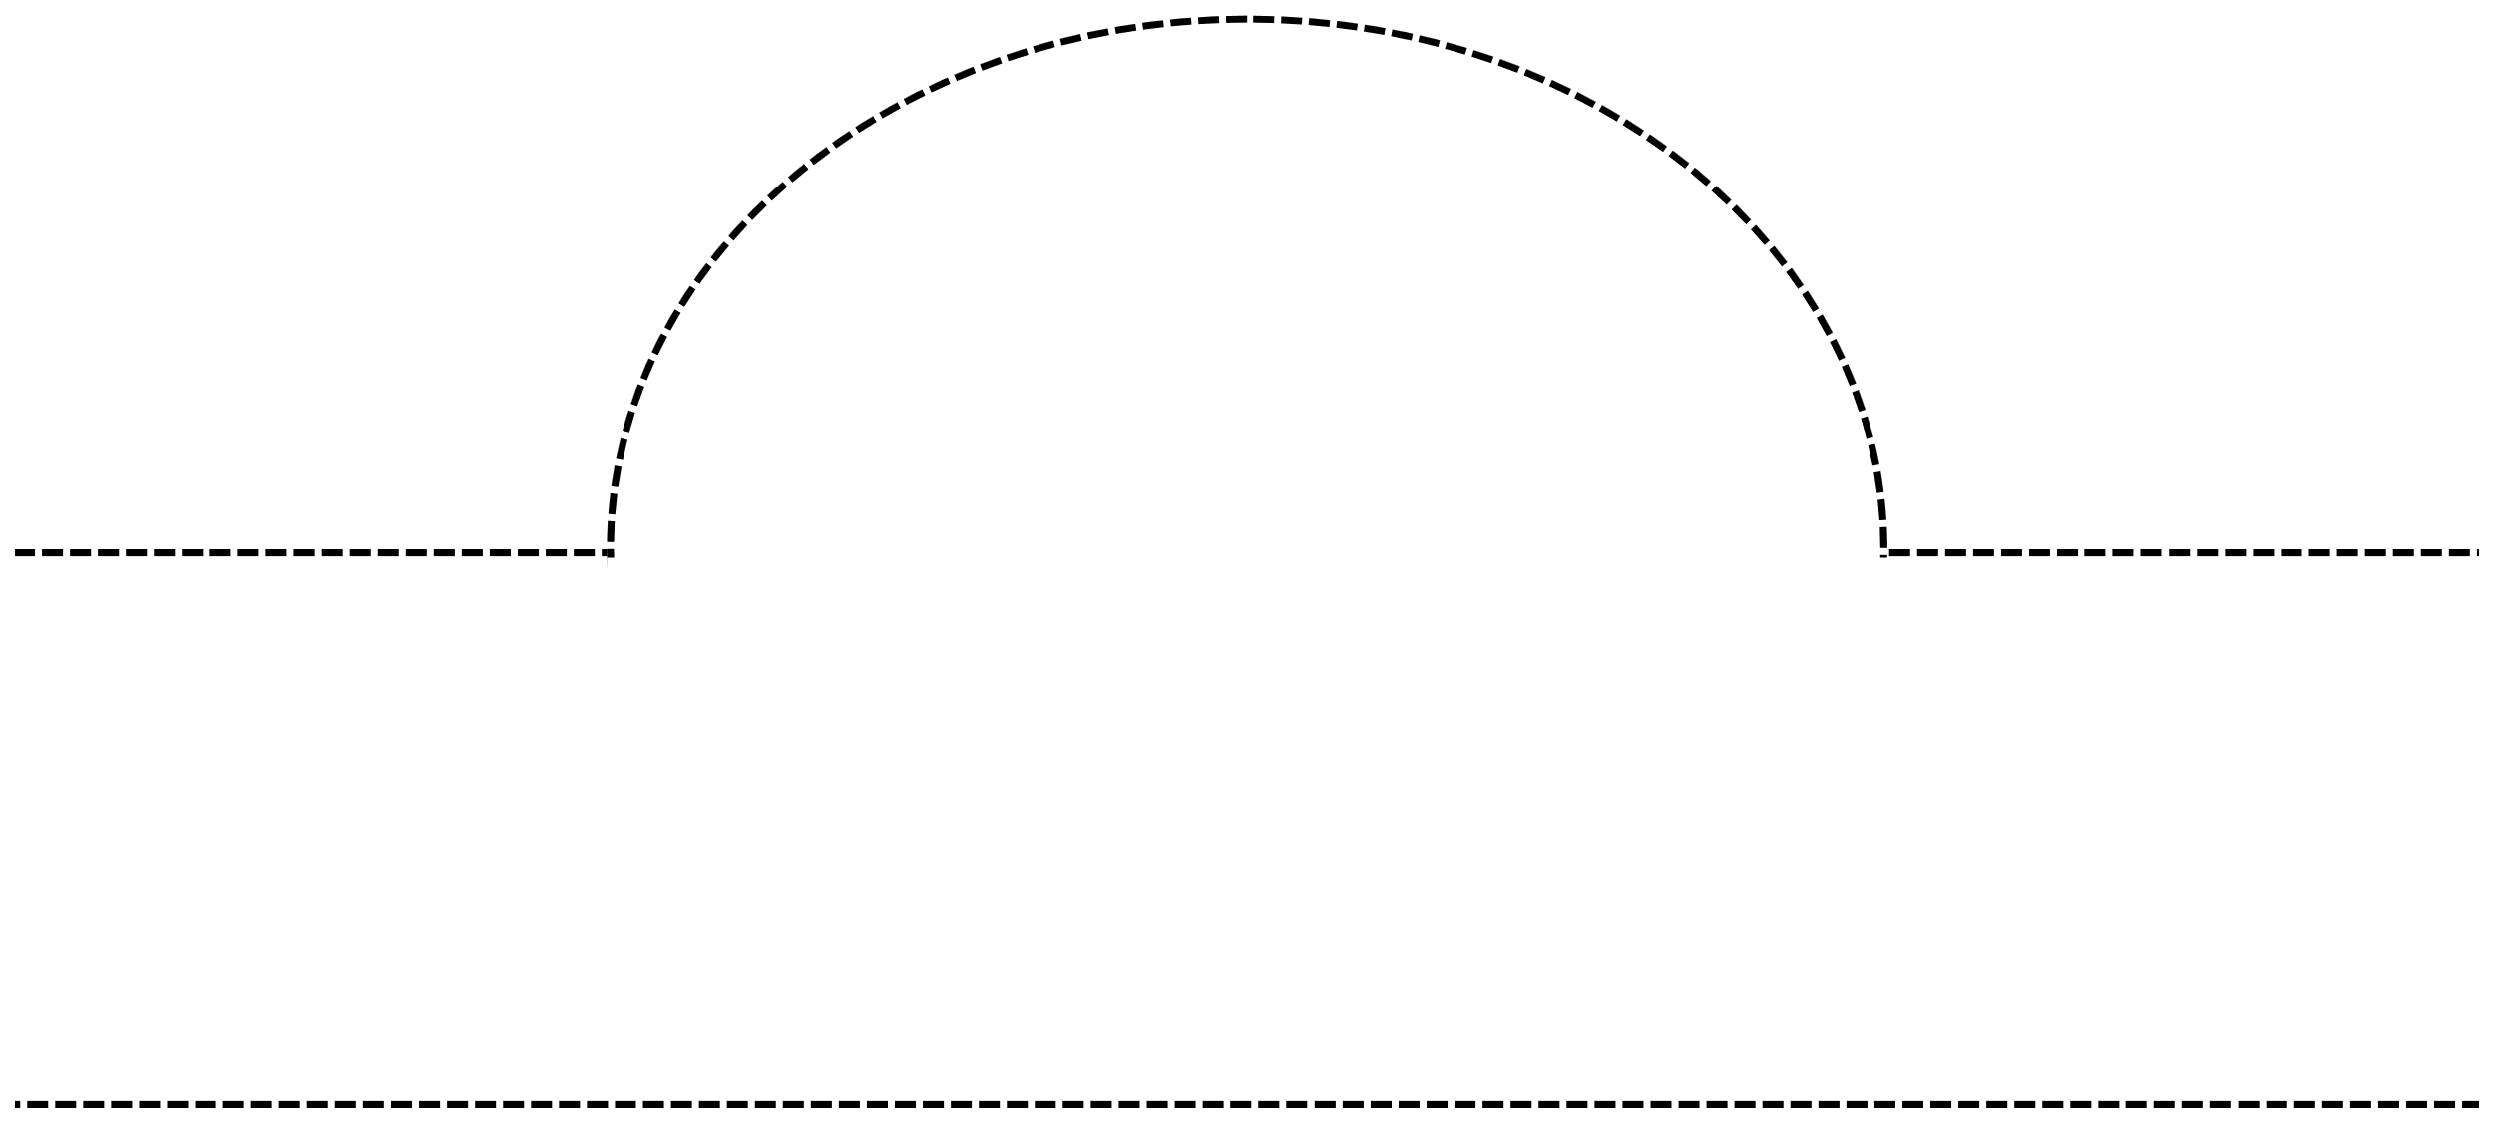




Materials:
White cardstock, coloring materials, scissors, tape/glue, easter paper crown printable template
Instructions:
Print and color the easter paper crown template
Cut out the template along the outer lines
Cut the 2-inch wide strips of paper and attach them
end to end
Attach the easter bunny crown template to the paper
strips
Fasten the two ends of the paper strip together to
create a circle
Wear your easter paper crown proudly!
Easter Paper
Crown

Slide 6
NOTE - ADDITIONAL PIECES FOR PAPER STRIPS IN ORDER TO MAKE MULTIPLE SIZES.

Slide 7


Slide 8








Slide 9
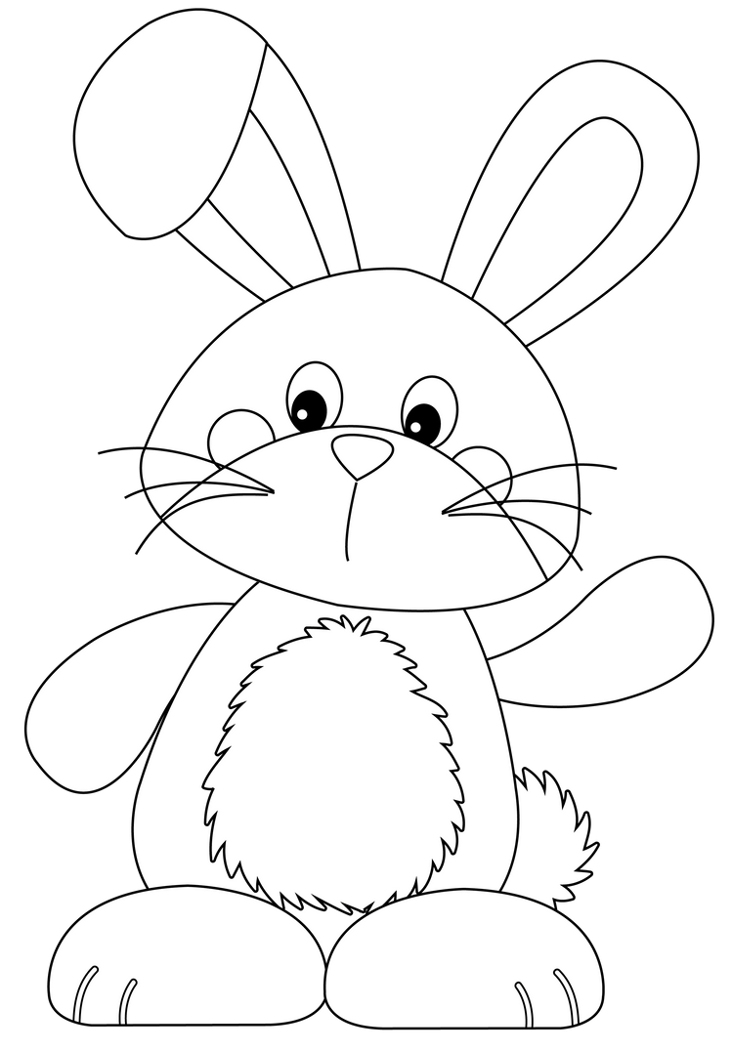
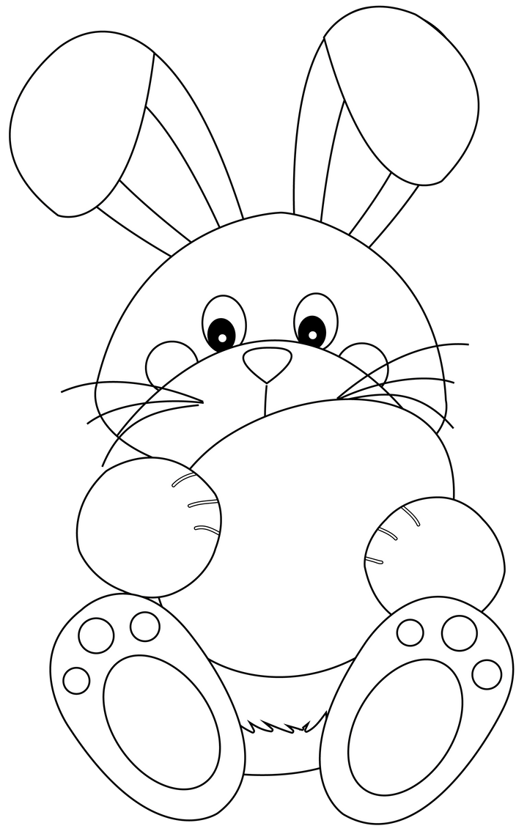
EASTER COLORING ACTIVITY

Slide 10









CAN YOU FIND
THESE EASTER ITEMS

Slide 11
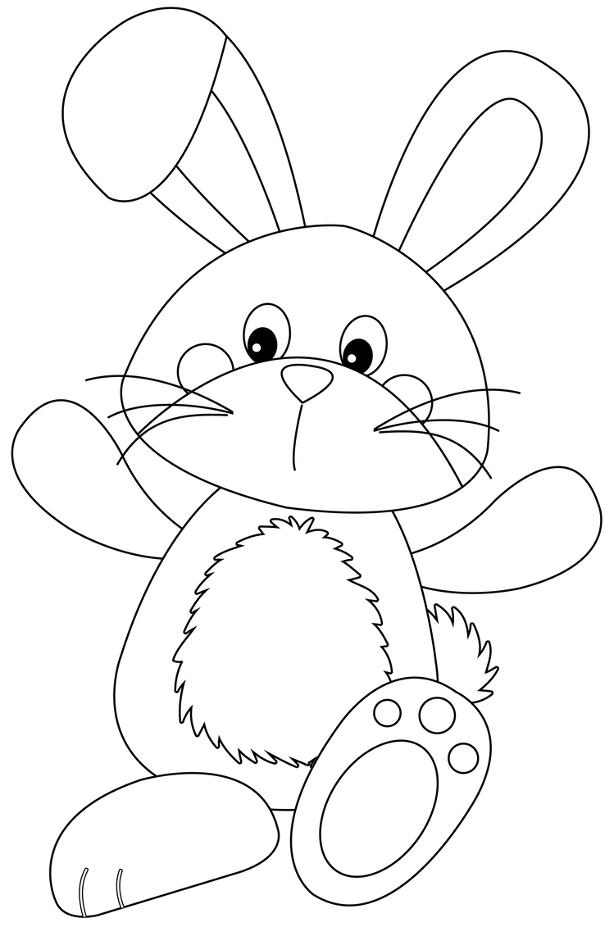
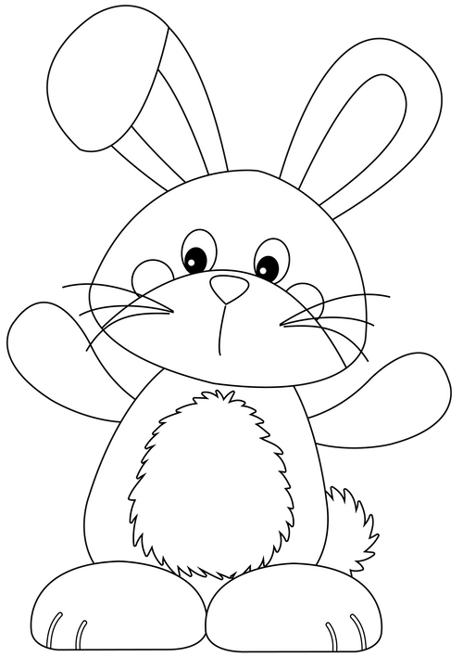
Easter FINGER PUPPET
1.PRINT OUT THE EASTER
FINGER PUPPET ON
CARDSTOCK PAPER.
2.COLOR IN THE FINGER
PUPPET WITH MARKERS, CRAYONS, OR COLORED
PENCILS.
3.CUT OUT THE FINGER
PUPPET ALONG THE
SOLID LINES AND THE
CIRCLE FOR THE FINGERS.
4.WEAR THE BUNNIES
WITH TWO FINGERS AS
BUNNY FEET!

Slide 12
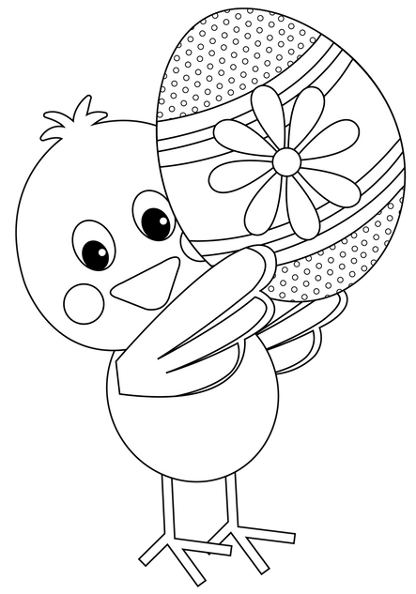
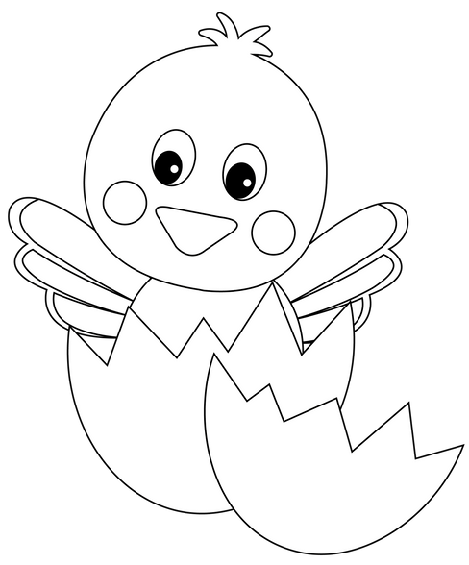
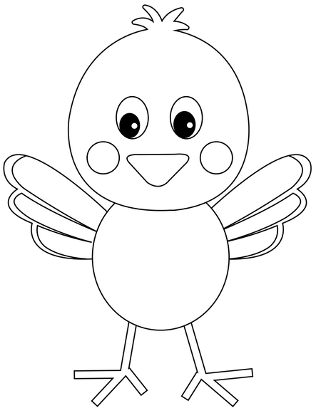
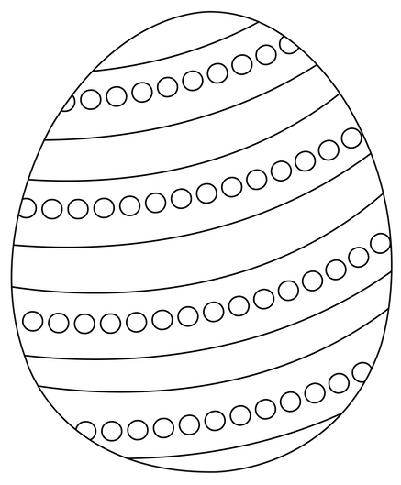
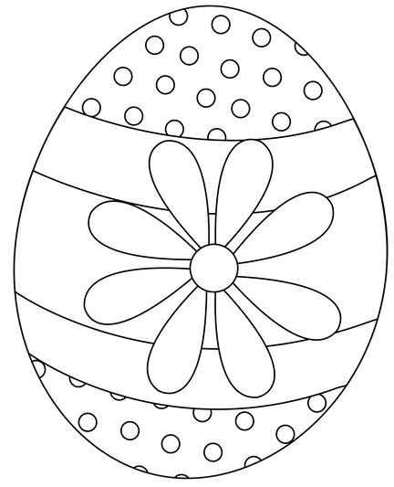
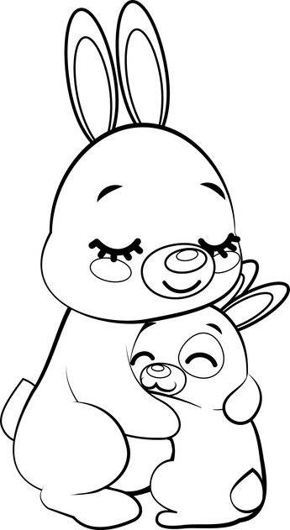


EASTER BOOKMARKS
Some
Bunny
Loves
you!
hAVE
AN
eGG-CELLENT
Easter!
Easter
Wishes
Hatching
soon
Hoppy
Easter!

Slide 13


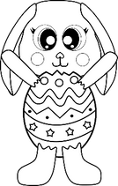












BUILD-A-BUNNY
Build a
Instructions:
1.Color each part 2.Cut all the parts 3.Build and paste

